Slide 1
Range and Inter-quartile Range
Notes:
Title page:
Font size 36, bold, theme color of the chapter (red for geometry, blue for algebra, green for statistics)

Slide 2


Consider the two sets of numbers:
Set A = {1, 3, 5, 5, 7, 9} Set B = {4, 5, 5, 5, 5, 6}
Do you remember how to measure the central tendency of a set of data?
We can use an average to measure.

Slide 3
Consider the two sets of numbers:
Set A = {1, 3, 5, 5, 7, 9} Set B = {4, 5, 5, 5, 5, 6}
Good! The commonly used averages include the mean, the median and the mode.
Try to find them for each set of numbers.
We can use an average to measure.

Slide 4
Consider the two sets of numbers:
Set A = {1, 3, 5, 5, 7, 9} Set B = {4, 5, 5, 5, 5, 6}
Mean of A
Mean of B
1
+
3
+
5
+
5
+
7
+
9
4
+
5
+
5
+
5
+
5
+
6
=
=
6
6
= 5
= 5
5
+
5
5
+
5
Median of A
=
Median of B
=
2
2
= 5
= 5
Mode of A
= 5
Mode of B
= 5

Slide 5

Consider the two sets of numbers:
Set A = {1, 3, 5, 5, 7, 9} Set B = {4, 5, 5, 5, 5, 6}
Mean of A = 5
Mean of B = 5
Median of A = 5
Median of B = 5
Mode of A = 5
Mode of B = 5
Although two sets of numbers have the same measures of central tendency, the numbers of each set spread out differently.

Slide 6
Consider the two sets of numbers:
Set A = {1, 3, 5, 5, 7, 9} Set B = {4, 5, 5, 5, 5, 6}
Mean of A = 5
Mean of B = 5
Median of A = 5
Median of B = 5
Mode of A = 5
Mode of B = 5
Distribution of set A
Distribution of set B
1 2 3 4 5 6 1 7 8 9
1 2 3 4 5 6 1 7 8 9

Slide 7

Consider the two sets of numbers:
Set A = {1, 3, 5, 5, 7, 9} Set B = {4, 5, 5, 5, 5, 6}
Mean of A = 5
Mean of B = 5
Median of A = 5
Median of B = 5
Mode of A = 5
Mode of B = 5
To measure how spread out or how dispersed the data are, we need some measures of dispersion. Range and inter-quartile range are two commonly used ones.

Slide 8

Range of Ungrouped Data
For ungrouped data:
range = largest datum – smallest datum
In general, the greater the range, the greater is the dispersion of the set of data.

Slide 9


Range of Ungrouped Data
For ungrouped data:
range = largest datum – smallest datum
Consider the data sets in the previous example.
1
9
Set A = {1, 3, 5, 5, 7, 9}
Set B = {4, 5, 5, 5, 5, 6}
4
6
Range of A
1
= 9 – 1
9
= 8
Range of B
= 6 – 4
6
4
= 2
Since the range of A > the range of B,
the data in set A are more dispersed.

Slide 10
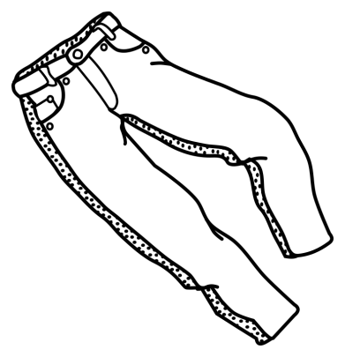
Follow-up question
The following shows the prices of 6 pairs of trousers in 2 shops.
Shop A: $250, $270, $350, $395, $420, $480
Shop B: $285, $310, $335, $385, $410, $450
(a) Find the range of prices of trousers in each shop.
(b) Which shop has less dispersed prices?
(a) Range of prices of trousers in shop A
= $(480 – 250)
= $230
Range of prices of trousers in shop B
= $(450 – 285)
= $165

Slide 11
Follow-up question
The following shows the prices of 6 pairs of trousers in 2 shops.
Shop A: $250, $270, $350, $395, $420, $480
Shop B: $285, $310, $335, $385, $410, $450
(a) Find the range of prices of trousers in each shop.
(b) Which shop has less dispersed prices?
(b) Since the range of prices for shop B < the range of
prices for shop A, the prices for shop B are less dispersed.

Slide 12

Range of Grouped Data
For grouped data:
range | = | upper class boundary of the last class interval | – | lower class boundary of the first class interval
Let us take a look in the following example.

Slide 13
The following table shows the ages of 50 employees.
Age | 20 – 24 | 25 – 29 | 30 – 34 | 35 – 39
Frequency | 11 | 18 | 15 | 6
24
25
Upper class boundary of the last class interval
= 39.5
Lower class boundary of the first class interval
= 19.5
∴ Range of the ages of the 50 employees
= 39.5 – 19.5
= 20
25
24
25
24

Slide 14
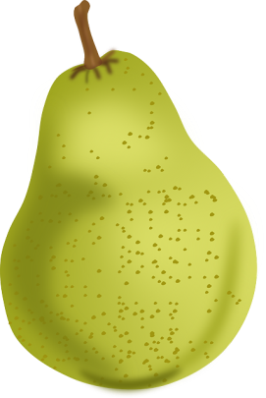
Follow-up question
The following table shows the weight distribution of pears in a fruit shop.
Find the range of weights of the pears.
Weight (g) | 180 − 199 | 200 − 219 | 220 − 239 | 240 − 259
Number of pears | 33 | 58 | 69 | 17
Range of weights of the pears
= (259.5 – 179.5) g
= 80 g
highest class boundary = 259.5 g
lowest class boundary = 179.5 g

Slide 15



The range of a data set is easy to find.
However, if there is a extreme datum in the data set, the value of the range will be greatly affected.
Right! In the following, we will introduce another measure of dispersion, the inter-quartile range, which is less affected by extreme values.

Slide 16
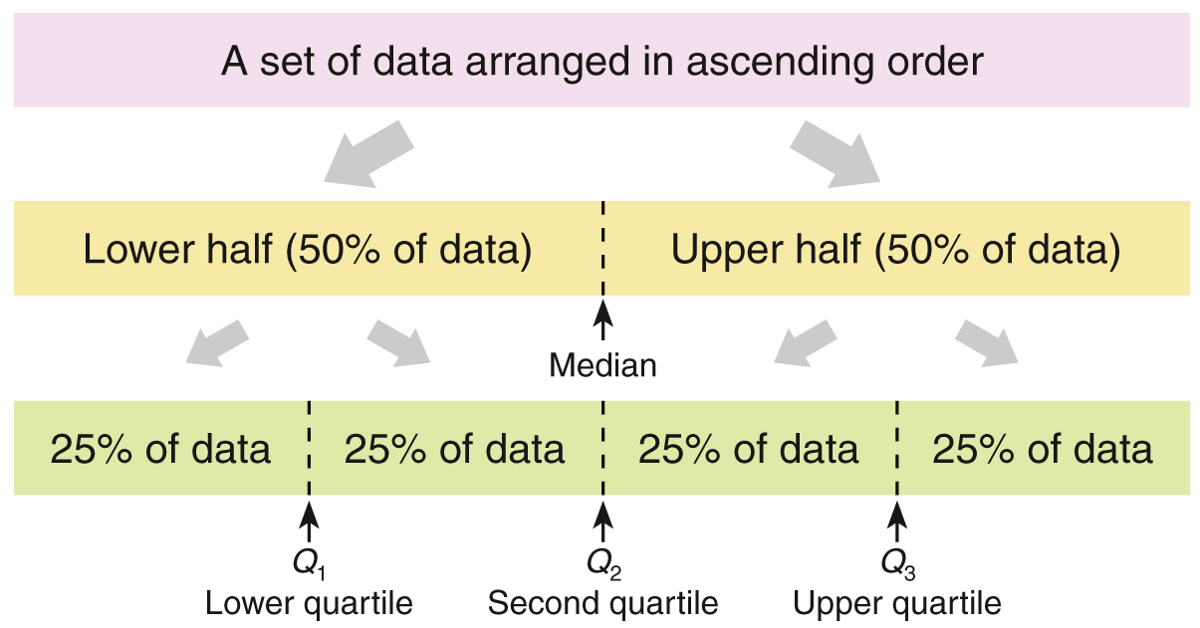
Inter-quartile Range of Ungrouped Data
For ungrouped data:
Median
The median divides the set of data into two equal parts.

Slide 17
Inter-quartile Range of Ungrouped Data
For ungrouped data:
Median
Q₁
Lower quartile
Q₂
Middle quartile
Q₃
Upper quartile
The quartiles divide the whole set of data into four equal parts.

Slide 18
Inter-quartile Range of Ungrouped Data
For ungrouped data:
Q₁
Lower quartile
Q₁
Lower quartile
Q₂
Middle quartile
Q₂
Middle quartile
Q₃
Upper quartile
Q₃
Upper quartile
Q₁ (or the first quartile) is the middle value of the lower half.
Q₂ (or the second quartile) is the median of the data set.
Q₃ (or the third quartile) is the middle value of the upper half.
The inter-quartile range (IQR) is defined as the difference between the upper quartile (Q₃ ) and the lower quartile (Q₁).
Inter-quartile range (IQR) = Q₃ – Q₁

Slide 19

In general, the greater the inter-quartile range, the greater is the dispersion of the set of data.

Slide 20
The procedures of finding the inter-quartile ranges of ungrouped data with an even number and an odd number of data are as follows.
A data set with an even number of data
9, 5, 1, 5, 3, 7
Step 1
Arrange the data in ascending order.
1, 3, 5, 5, 7, 9
Step 2
Divide the whole data set into two equal halves.
Lower half
Upper half
1, 3, 5, 5, 7, 9
Q₂

Slide 21
Lower half
Upper half
1, 3, 5, 5, 7, 9
Q₁
Q₃
Q₂
Step 3
Find the median of each half of the data set.
Q₃ = 7
Q₁ = 3,
Step 4
Find the inter-quartile range of the data set.
Inter-quartile range = Q₃ − Q₁
= 7 − 3
= 4

Slide 22
A data set with an odd number of data
8, 6, 2, 4, 7
Step 1
Arrange the data in ascending order.
2, 4, 6, 7, 8
Step 2
Divide the whole data set into two equal halves.
Lower half
Upper half
2, 4, 6, 7, 8
Q₂

Slide 23
Lower half
Upper half
2, 4, 6, 7, 8
Q₁
Q₃
Q₂
Step 3
Find the median of each half of the data set.
Step 4
Find the inter-quartile range of the data set.
Inter-quartile range = Q₃ − Q₁
= 7.5 − 3
= 4.5

Slide 24
Follow-up question
The waiting times (in min) of customers for bank services along two queues in front of two ATM machines are recorded below.
ATM A: 3.8, 6.5, 8.3, 15.3, 1.9, 5.8, 5.3, 13.9
ATM B: 6.7, 13.6, 4.7, 5.5, 9.1, 8.5, 7.6, 4.8
For each ATM, find the inter-quartile range of the waiting times of the customers.
Based on the results in (a), which ATM’s waiting times have a greater dispersion?
(a) Inter-quartile range of the waiting times for ATM A
◄ 1.9, 3.8, 5.3, 5.8, 6.5, 8.3, 13.9, 15.3
lower half upper half

Slide 25
Follow-up question
The waiting times (in min) of customers for bank services along two queues in front of two ATM machines are recorded below.
ATM A: 3.8, 6.5, 8.3, 15.3, 1.9, 5.8, 5.3, 13.9
ATM B: 6.7, 13.6, 4.7, 5.5, 9.1, 8.5, 7.6, 4.8
For each ATM, find the inter-quartile range of the waiting times of the customers.
Based on the results in (a), which ATM’s waiting times have a greater dispersion?
(a) (cont’d)
Inter-quartile range of the waiting times for ATM B
◄ 4.7, 4.8, 5.5, 6.7, 7.6, 8.5, 9.1, 13.6
lower half upper half

Slide 26
Follow-up question
The waiting times (in min) of customers for bank services along two queues in front of two ATM machines are recorded below.
ATM A: 3.8, 6.5, 8.3, 15.3, 1.9, 5.8, 5.3, 13.9
ATM B: 6.7, 13.6, 4.7, 5.5, 9.1, 8.5, 7.6, 4.8
For each ATM, find the inter-quartile range of the waiting times of the customers.
Based on the results in (a), which ATM’s waiting times have a greater dispersion?
(b) ∵ IQR for ATM A > IQR for ATM B
∴ Based on the inter-quartile range, the waiting times
for ATM A have a greater dispersion.

Slide 27
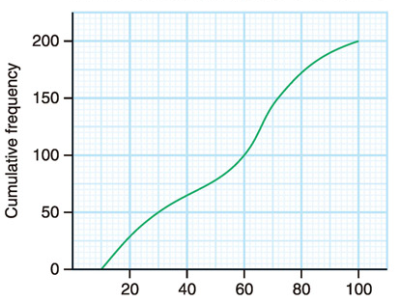
Inter-quartile Range of Grouped Data
For grouped data, we also have:
inter-quartile range = Q₃ – Q₁
Consider the cumulative frequency curve below:
25% of the total frequency
= 200 25%
= 50
From the graph, the lower quartile (Q₁) is 30.
Q₁

Slide 28
Inter-quartile Range of Grouped Data
For grouped data, we also have:
inter-quartile range = Q₃ – Q₁
Consider the cumulative frequency curve below:
75% of the total frequency
= 200 75%
= 150
From the graph, the upper quartile (Q₃) is 72.
Q₁
Q₃

Slide 29
Inter-quartile Range of Grouped Data
For grouped data, we also have:
inter-quartile range = Q₃ – Q₁
Consider the cumulative frequency curve below:
Q₁ = 30
Q₃ = 72
∴ IQR = 72 – 30 = 42
Q₁
Q₃

Slide 30
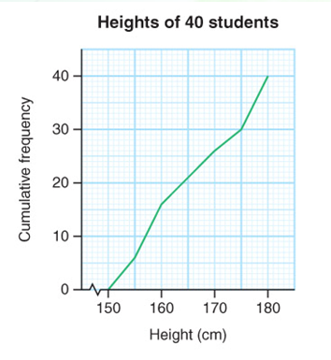
Follow-up question
The cumulative frequency polygon
on the right shows the heights of
40 students.
(a) Find the lower quartile and the
upper quartile of the heights
of the students.
(b) Find the inter-quartile range of
the heights of the students.
Q₁
Q₃
(a) From the graph,
lower quartile Q₁ = 157 cm
upper quartile Q₃ = 175 cm

Slide 31
Follow-up question
The cumulative frequency polygon
on the right shows the heights of
40 students.
(a) Find the lower quartile and the
upper quartile of the heights
of the students.
(b) Find the inter-quartile range of
the heights of the students.
Q₁
Q₃
(b) Inter-quartile range
= Q₃ – Q₁
= (175 – 157) cm
= 18 cm

